Slide 1
_{Green Energy Shifting App}
Members:
Veronika Henk
Sarvenaz Golchin
Mahnaz Hajibaba
Mentor: Simon Scerri

Slide 2
Introduction
What is the goal of this application?
How is it useful? Who benefits from this application?

Slide 3
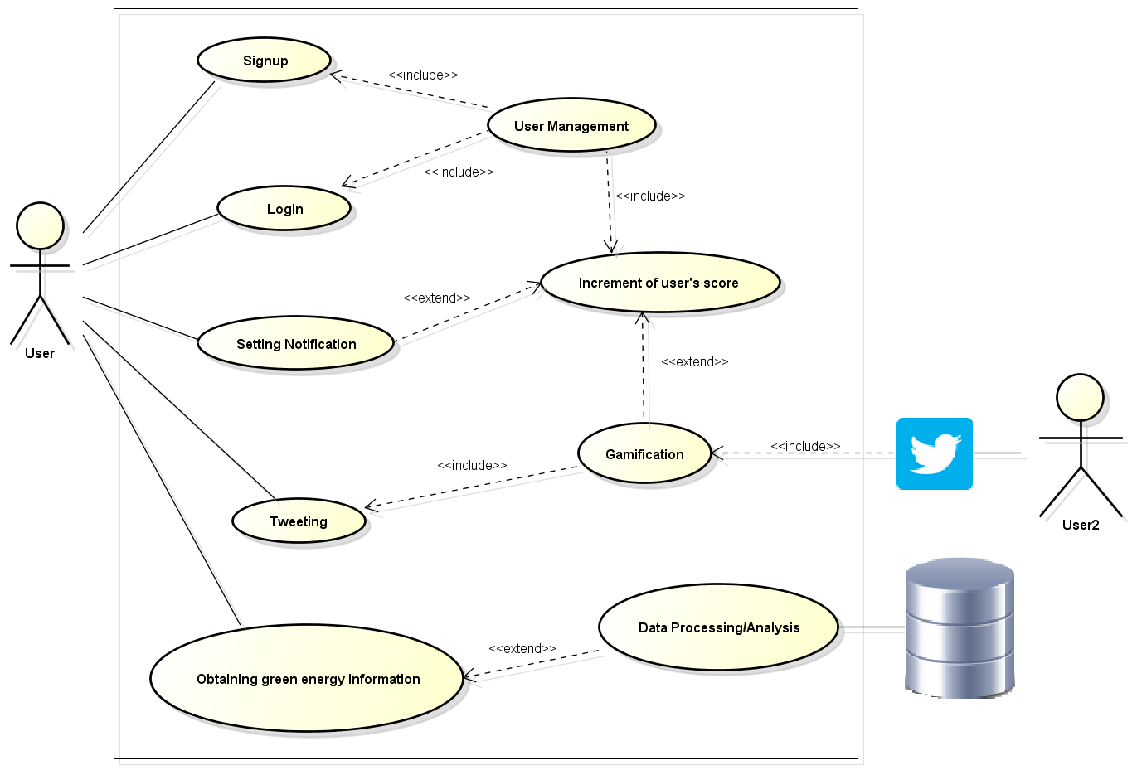
System Overview

Slide 4
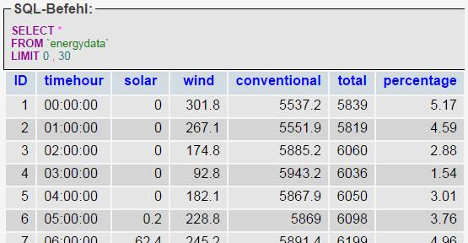
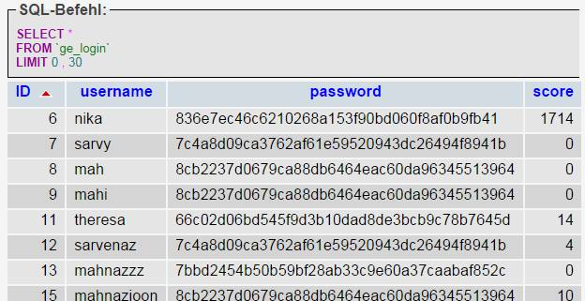
Data
User - data retrieved from user for identification
Hourly ex-ante and ex-post test-data from
May 15th 2012, since we could not access real live-data
Retrieved from “Transparency Data Interface
Specification” by “EEX Information Products”

Slide 5
Testing
Unit Testing:
Increase the stability and quality of an application
Reduce testing costs
Integration Testing:
- Verifying that individual application components work together as expected by the user

Slide 6
Documentation
Technical Documentation
Software Architecture
Data Structure
Web Services (PHP)
Testing
Javadoc
- Precise description of each class in the Android project
User Manual
Overview
Requirements
Using the System

Slide 7
Challenges
Unable to access the server from outside the university network
Web services and data are on a private web server
Unable to acquire real live-data

Slide 8

Demo

